Slide 1
Mapping customers A guide to interactive thematic maps for marketing analytics
andrea.bublitz@uzh.ch
Mapping customers
Salome Lang

Slide 2
Mapping Customers Agenda
Outline
Research Question
Introduction to Mapping
Data Screening & Descriptives
§ Implementation in R
Summary
References
1
2
3
4
5
6
Mapping Customers | Research Question
Salome Lang
1

Slide 3
Data visualizations are essential in marketing analytics and maps are a popular form of visualization
Question/Task
To communicate results by visualizing them for internal and external stakeholders is an important task in marketing analytics
When the data includes geographic information (which is often the case with customer transaction data for example), an obvious option is to visualize it on a map
Furthermore, it is often desirable to let the addressee interact with the analysis, ask own questions, and directly get the according answers
 | The following presentation will guide you through the creation of an interactive thematic map on the example of a retailer’s customer transaction data
Mapping Customers | Research Question
Salome Lang
1

Slide 4
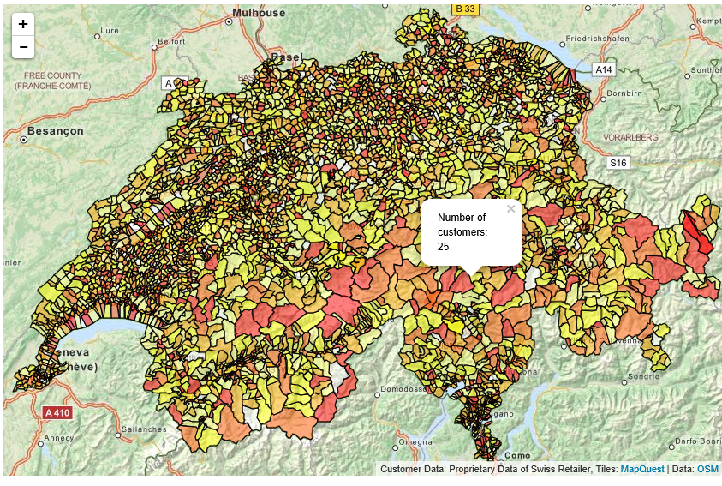
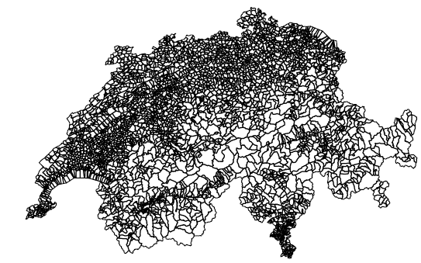
The weighted interactive map requires three inputs
Input/Output
Customer transaction data including geographical information
Input
Output
Customer ID | AggPurchase | ZIP code
565428 | 4,262.2 | 4532
171796 | 2,916.4 | 4436
810696 | 1,525.3 | 8006
Population statistics on same geographic layer
ZIP code | Total population | Female
1000 | 2,964 | 1,485
1003 | 8,269 | 4,126
1004 | 28,996 | 15,013
Shapefile containing the polygon shapes
Interactive thematic map of the customer data weighted by population size
Mapping Customers | Research Question
Salome Lang
1

Slide 5
Mapping Customers Agenda
Outline
Research Question
Introduction to Mapping
Data Screening & Descriptives
§ Implementation in R
Summary
References
1
2
3
4
5
6
Mapping Customers | Introduction to Mapping
Salome Lang
2

Slide 6
Imagine you consulted a retail firm…
Theory
Empirical studies suggest that advertising in retail stores is more successful if tailored to the local environment because location characteristics affect
The attractiveness of certain product categories
Customers’ reaction to store flyers and advertised deals
Relevant environmental variables are in particular
Socio-demographics of the inhabitants of the store’s trading area
Nature and intensity of local competition
Gijsbrechts et al. (2003)
Campo et al. (2000)
Mapping Customers | Introduction to Mapping
Salome Lang
2

Slide 7
… you would like to draw an informative map
Goal
Then you should avoid two major pitfalls in drawing thematic maps:
Maps are not a shortcut in your data screening process
Make sure your map answers the right question
 |  | Goal
 | To advertise more successfully, you want to provide a thematic map that facilitates decision making for the retailer.
Mapping Customers | Introduction to Mapping
Salome Lang
2

Slide 8
Visualizing data on a map is only the cherry on the cake
Pitfall I
Mapping attributes of spatial objects in R is a rather involved task
Therefore, it is even more important for your to know what the map should show you before you draw it, i.e.
Get to know your data by screening it carefully
Get simple descriptives, such as histograms, of your variables of interest before you plot the map
Mapping Customers | Introduction to Mapping
Salome Lang
2

Slide 9
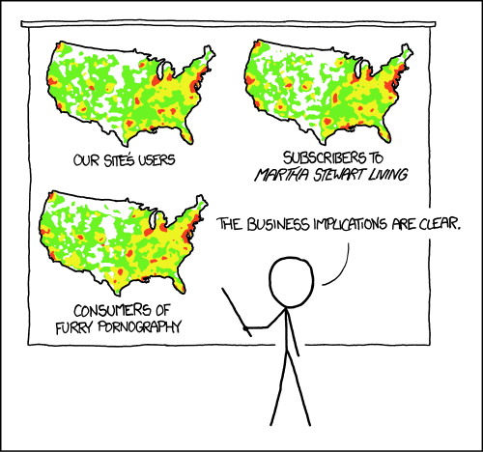
Maps of absolute values usually answer the wrong question
Pitfall II
Absolute values plotted on maps answer the question “Where do most people live?”, which is usually not the question of interest
https://xkcd.com/1138/
 | Now you know why we need population statistics as an input to the map
Mapping Customers | Introduction to Mapping
Salome Lang
2

Slide 10
Mapping Customers Agenda
Outline
Research Question
Introduction to Mapping
Data Screening & Descriptives
§ Implementation in R
Summary
References
1
2
3
4
5
6
Mapping Customers | Data Screening & Descriptives
Salome Lang
3

Slide 11
To avoid pitfall I, we carefully screen the data
Screening
Data Set | Variable | Measurement |  |  | Descriptive Statistics
 |  | Range | Type | No. cases | No. missing values | Mean
Customer data | Customer ID | 3493-902016 | Integer | 156321 | 0 | -
 | AggPurchase | 0-394882 | Numeric | 156321 | 0 | 8983
 | PLZ | 1000-9658 | Integer | 156321 | 1518 | -
 | City | - | Character | 156321 | 1518 | -
Population statistics | PLZ | 1000-9658 | Integer | 3189 | 0 | -
 | Total | 1-38904 | Integer | 3189 | 0 | 2583
 | …
Mapping Customers | Data Screening & Descriptives
Salome Lang
3

Slide 12
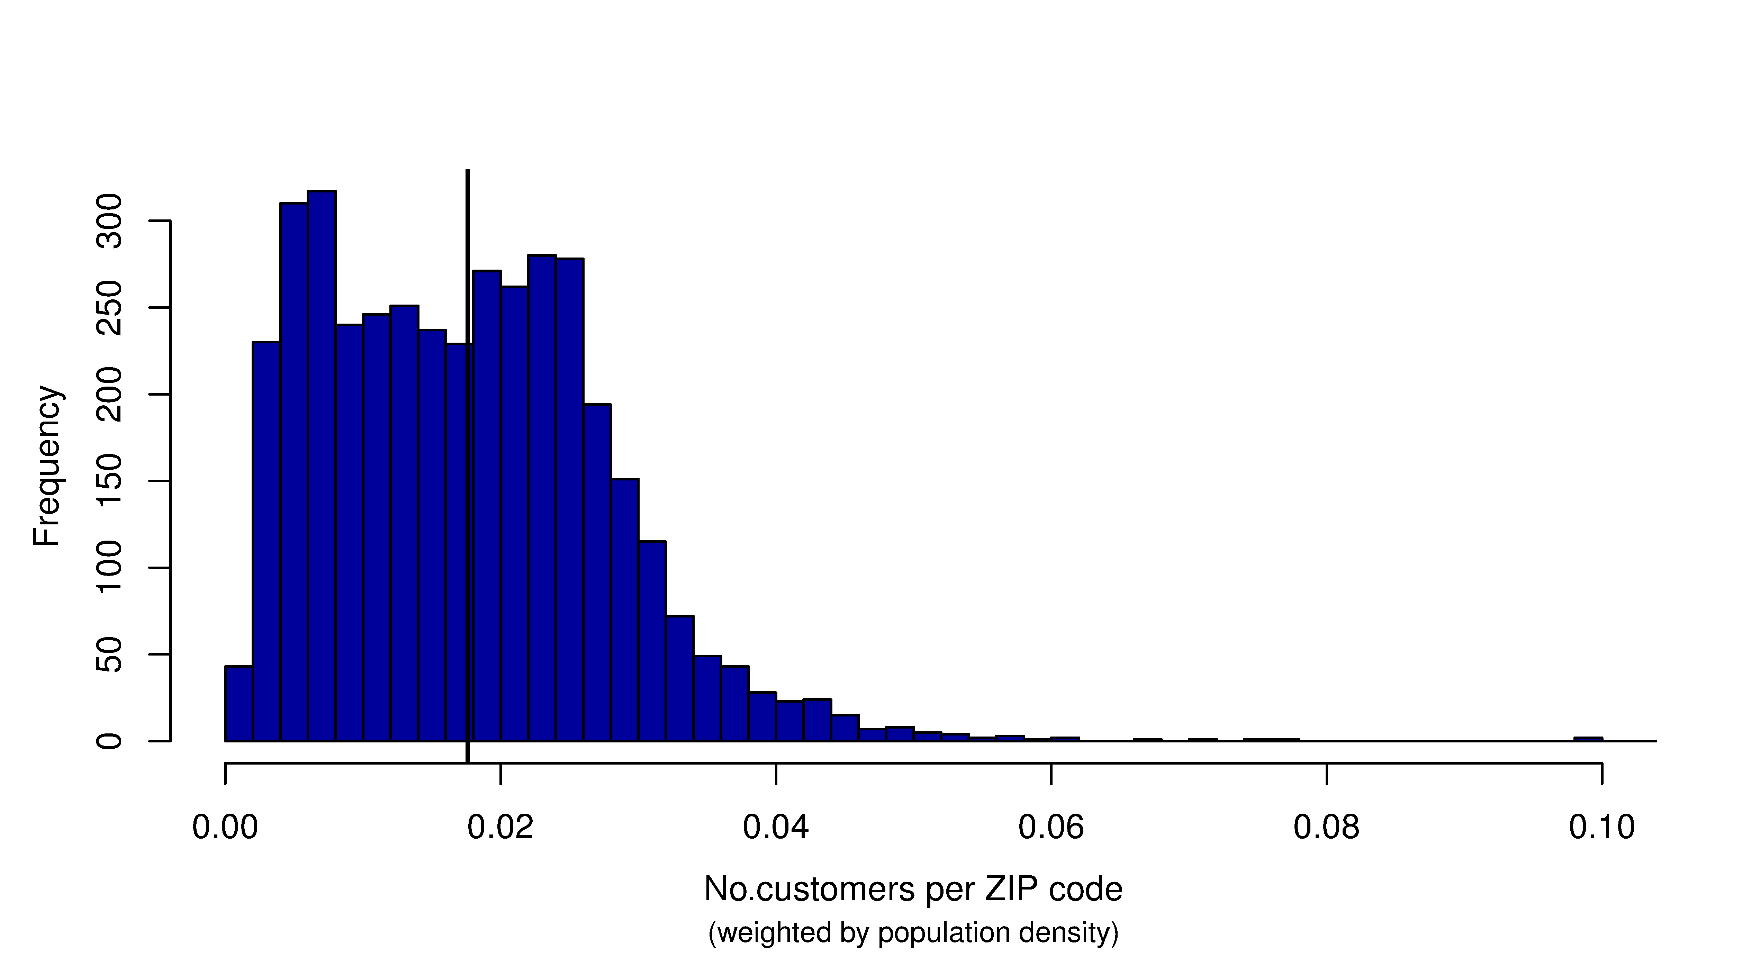
In most ZIP code areas, the retailer reaches less than 4% of the population
Screening
Mean = 0.0176
 | This is the variable of interest for the maps: number of customers weighted by population
Mapping Customers | Data Screening & Descriptives
Salome Lang
3

Slide 13
Mapping Customers Agenda
Outline
Research Question
Introduction to Mapping
Data Screening & Descriptives
§ Implementation in R
Summary
References
1
2
3
4
5
6
Mapping Customers | Implementation in R
Salome Lang
4

Slide 14
If you remember anything of this presentation, it should be these two points
Implementation
There are two lines of code that may cost you an awful lot of time when dealing with maps
About merging attributes to shapefiles: Don’t touch the polygons!
If you want to plot your map on a base map to enable zoom and interactive features: Check the Coordinate Reference Systems (CSR) of the maps!
Mapping Customers | Implementation in R
Salome Lang
3

Slide 15
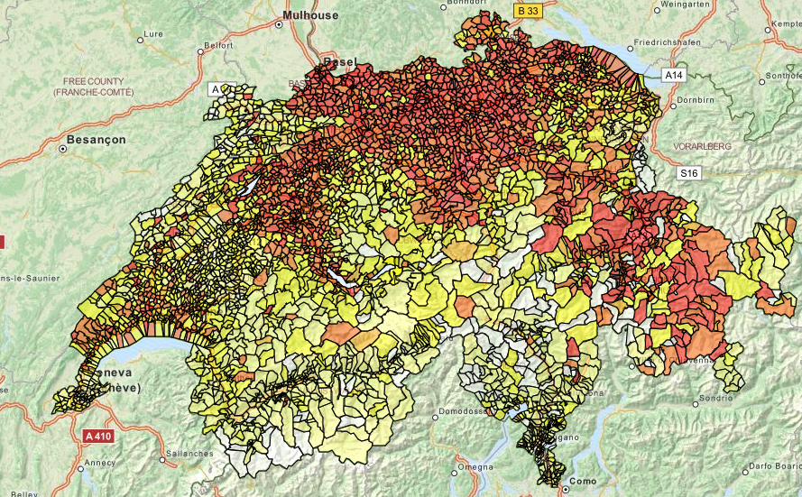
This the map for the number of customers weighted by population density…
Maps
Mapping Customers | Implementation in R
Salome Lang
3

Slide 16
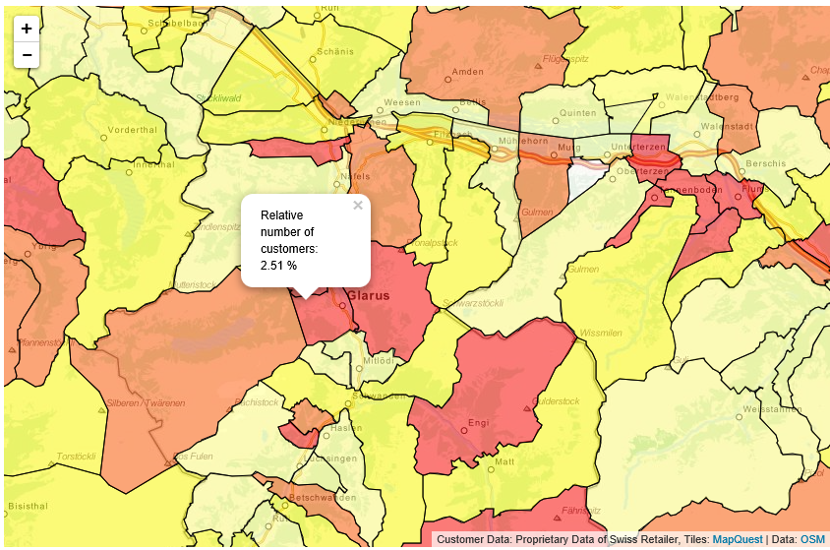
…and it has pop ups and a zoom
Maps
Click on a ZIP code area to get more information
Zoom in and profit from all features of OSM
Mapping Customers | Implementation in R
Salome Lang
3
Notes:
Go to R and show Map 1: Relative customer numbers

Slide 17
Mapping Customers Agenda
Outline
Research Question
Introduction to Mapping
Data Screening & Descriptives
§ Implementation in R
Summary
References
1
2
3
4
5
6
Mapping Customers | Summary
Salome Lang
5

Slide 18
Maps may not always be more useful, but they are pretty…
Summary
In practice, many analytical questions can be answered with histograms and scatter plots just as well as with a map.
If you decide to visualize your data on a map nevertheless, be aware that
Maps are not a shortcut in your data screening process
Often, you need to weight values by population to answer the right question
 | Once you have tackled how spatial data objects work, R offers so much flexibility in drawing maps (not comparable to Stata for example). Even if a histogram answers the question as well as a map, the maps are definitely more impressive…
Mapping Customers | Summary
Salome Lang
5
Notes:
Go to R and show Map 2: Market Potential

Slide 19
Mapping Customers Agenda
Outline
Research Question
Introduction to Mapping
Data Screening & Descriptives
§ Implementation in R
Summary
References
1
2
3
4
5
6
Mapping Customers | References
Salome Lang
6

Slide 20
References
References
Brunsdon, Chris, and Lex Comber. An Introduction to R for Spatial Analysis Et Mapping. London: Sage, 2015.
Campo, K., Gijsbrechts, E., Goossens, T., & Verhetsel, A. (2000). The impact of location factors on the attractiveness and optimal space shares of product categories. International Journal of Research in Marketing, 17(4), 255-279.
Frazier, M.: Overview of Coordinate Reference Systems (CRS) in R. Link: https://www.google.ch/url?sa=t&rct=j&q=&esrc=s&source=web&cd=1&cad=rja&uact=8&ved=0ahUKEwi_xrqHirjJAhUDIg8KHbMOB3sQFggeMAA&url=https%3A%2F%2Fwww.nceas.ucsb.edu%2F~frazier%2FRSpatialGuides%2FOverviewCoordinateReferenceSystems.pdf&usg=AFQjCNHm-nq1ZLij4bTWVM-5SR4Ygs-Xyw&sig2=JZtr4LpwkR9fxzOJtpJjEw
Mapping Customers | References
Salome Lang
6

Slide 21
References
References
Gijsbrechts, E., Campo, K., & Goossens, T. (2003). The impact of store flyers on store traffic and store sales: a geo-marketing approach. Journal of Retailing, 79(1), 1-16.
Keck, François. Rleafmap: interactive maps with R and leaflet. http://www.francoiskeck.fr/rleafmap/
Mapping Customers | References
Salome Lang
6

Slide 22
Social Customer Relationship Management: Group Assignment
Salome Lang salome.lang@uzh.ch
Mapping Customers

